Slide 1
Researching Project IoT Platform using Laravel and Mobile App
‘ Week3 Report ’
Lecturer: Mr. HEL Chanthan
Prepared by Mr. VANNAK Sovannroth
2019-2020

Slide 2
Outline
Planning for First Month.
Installation Wampserver for running phpMyAdmin
Bootstrap Template
For Front-End
For Backend
Installation Laravel for Project
Running Server
Creating Database MySQL
Installation Laravel Module for Backend and Front-End
Module for Backend
Module for Front-End
PAGE 01

Slide 3
Planning for First Month
Activity (Start on 06.08.2020) | Thursday (Presentation day) | Friday | Monday | Tuesday | Wednesday (Meeting day)
Week 1 | Installation MongoDB (Shell and Compass) and connect localhost between Shell and Compass.(Locally) | Performing CRUD (Create, Read, Update, Delete) on Mongo Shell and MongoDB Compass. | Creating MongoDB Atlas account and connect it to Mongo Shell or MongoDB Compass, and Driver (Node.js).(Cloud) | Installation Visual Studio Code and connect driver to MongoDB Atlas.(Cloud) | Connecting sample Backend to MongoDB Cluster and storing Products in the Database.
Week 2 | Connecting driver to Mongo Shell.(Locally) | Starting to build sample backend connect with or without MongoDB Atlas. | Build creating, editing and deleting Products on server. | Transmitting and fetching data to/from the Database. | Creating Login and Signup. (Email and password)
Week 3 | Learning template Bootstrap 4 | Install wampserver and Laravel | Run Laravel server with MySQL(Database) | Choose free template Bootstrap for Front-End & Backend | Installation Laravel Module for Backend and Front-End
Week 4 | Starting to build backend for project. & Creating Login and Signup. | User management: • Create new user • Reset user password • Delete and edit user | Manage Info: • Logo • Name • Contact info • Map • Social | Manage new category: • Create new category • Edit and delete exiting categories. | Manage news: • Post news • Edit news • Delete news
PAGE 02

Slide 4
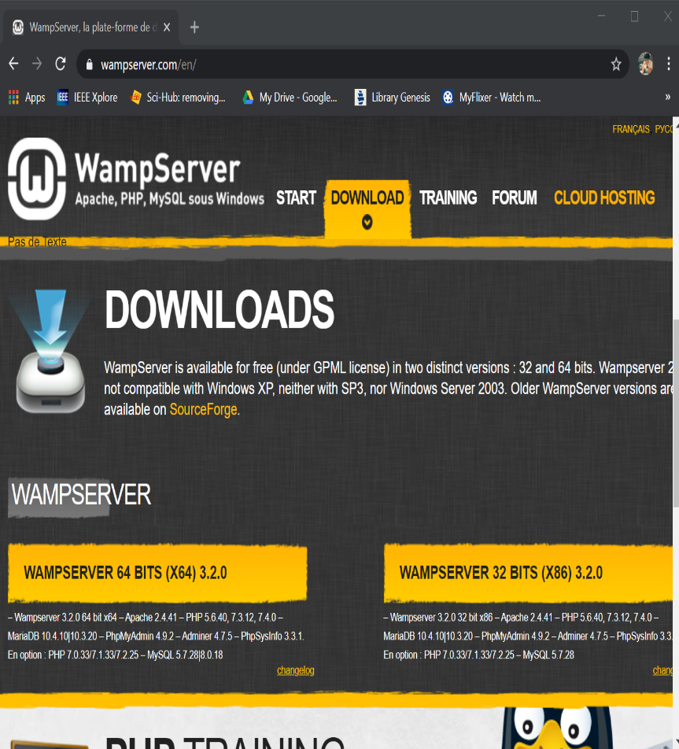
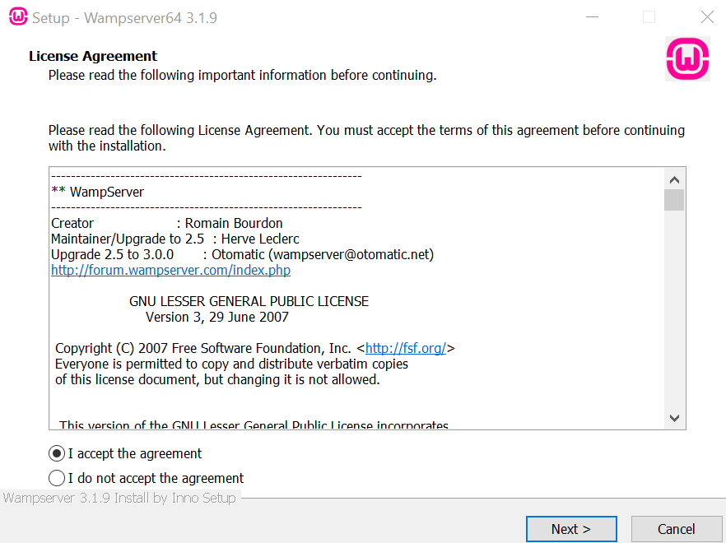
Installation Wampserver for running phpMyAdmin
PAGE 03

Slide 5
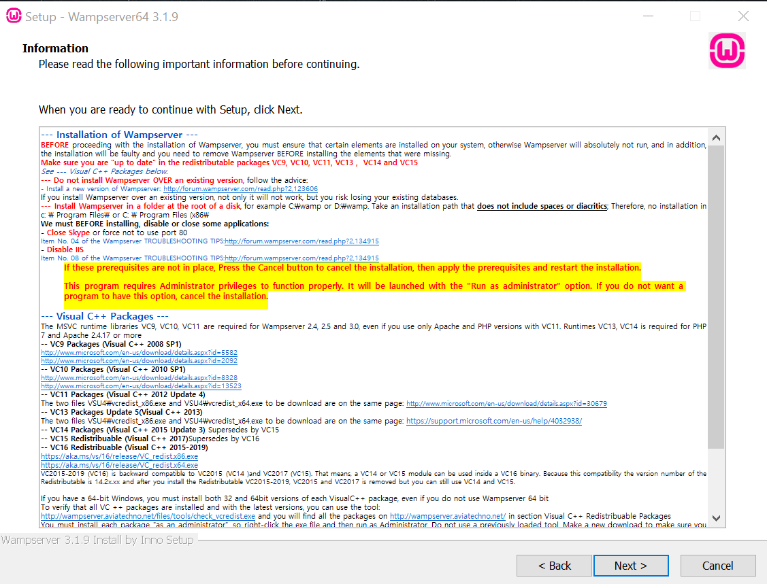
Installation Wampserver for running phpMyAdmin
Download all Packages and install it.
PAGE 04

Slide 6
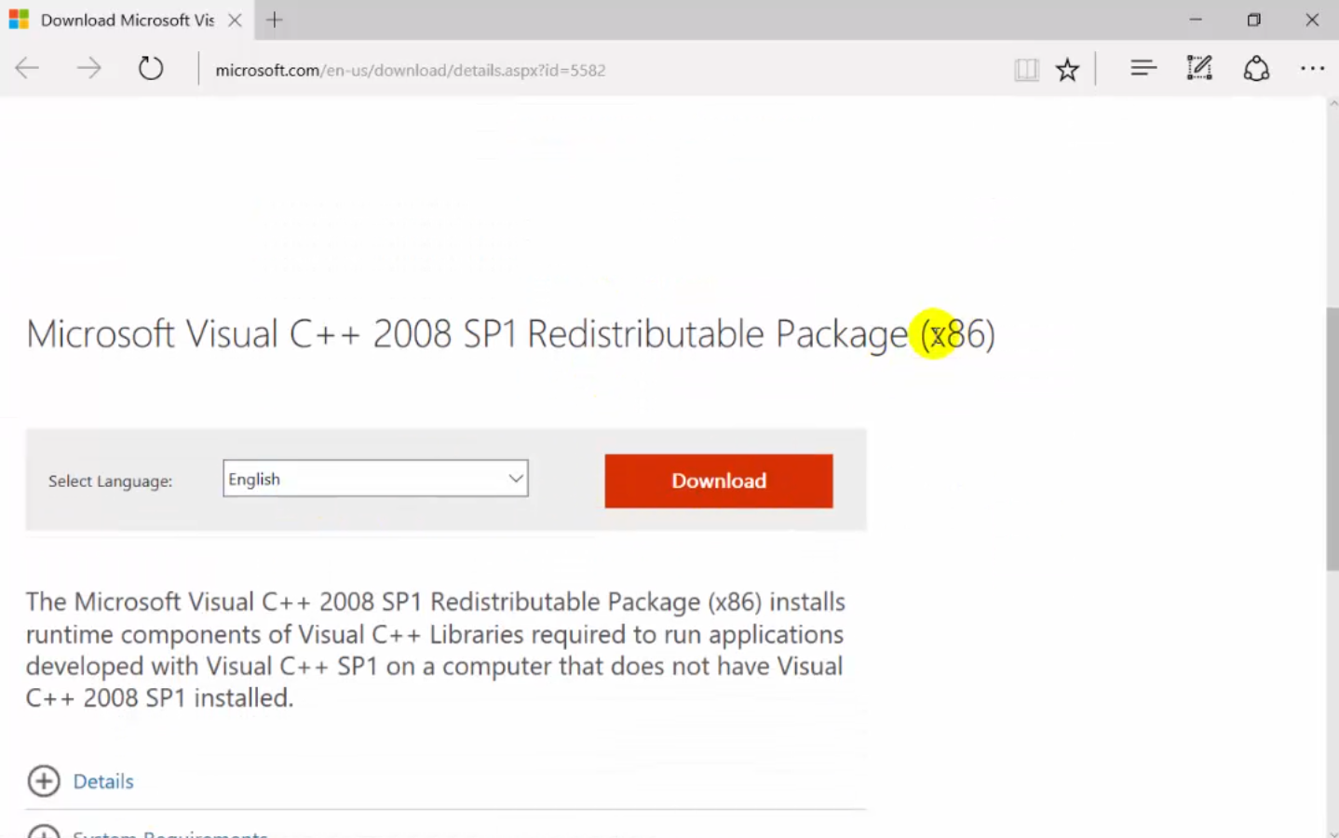
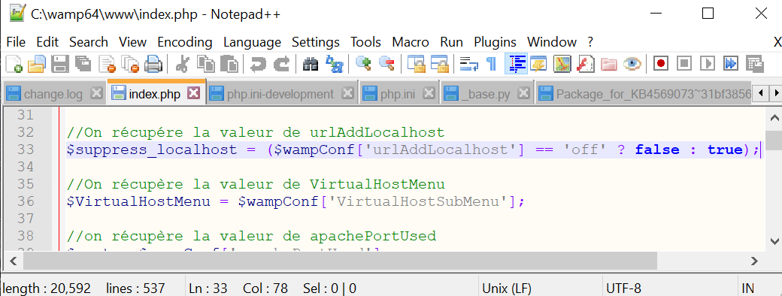
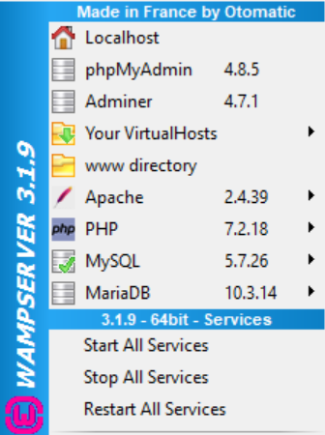
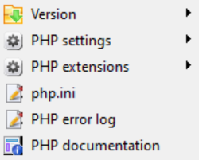
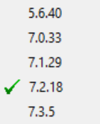
Installation Wampserver for running phpMyAdmin
Sample download Package Microsoft Visual C++ 2008 .
Must change $suppress_localhost true : false to false : true.
Choose version PHP
PAGE 05

Slide 7
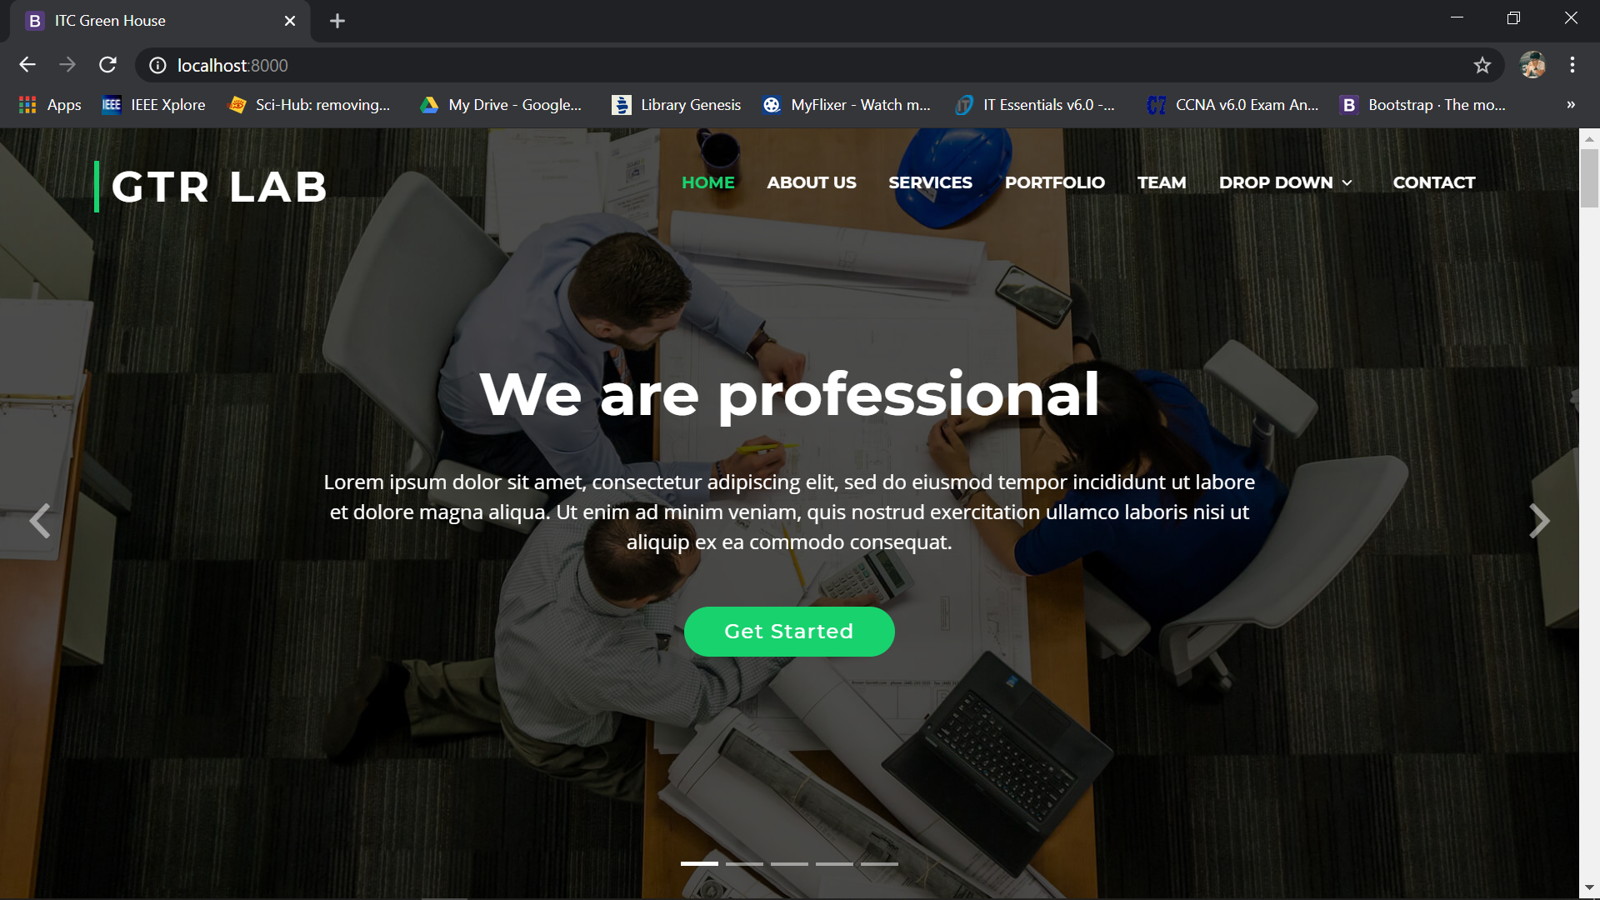
Bootstrap Template
For Front-End
https://bootstrapmade.com
PAGE 06

Slide 8
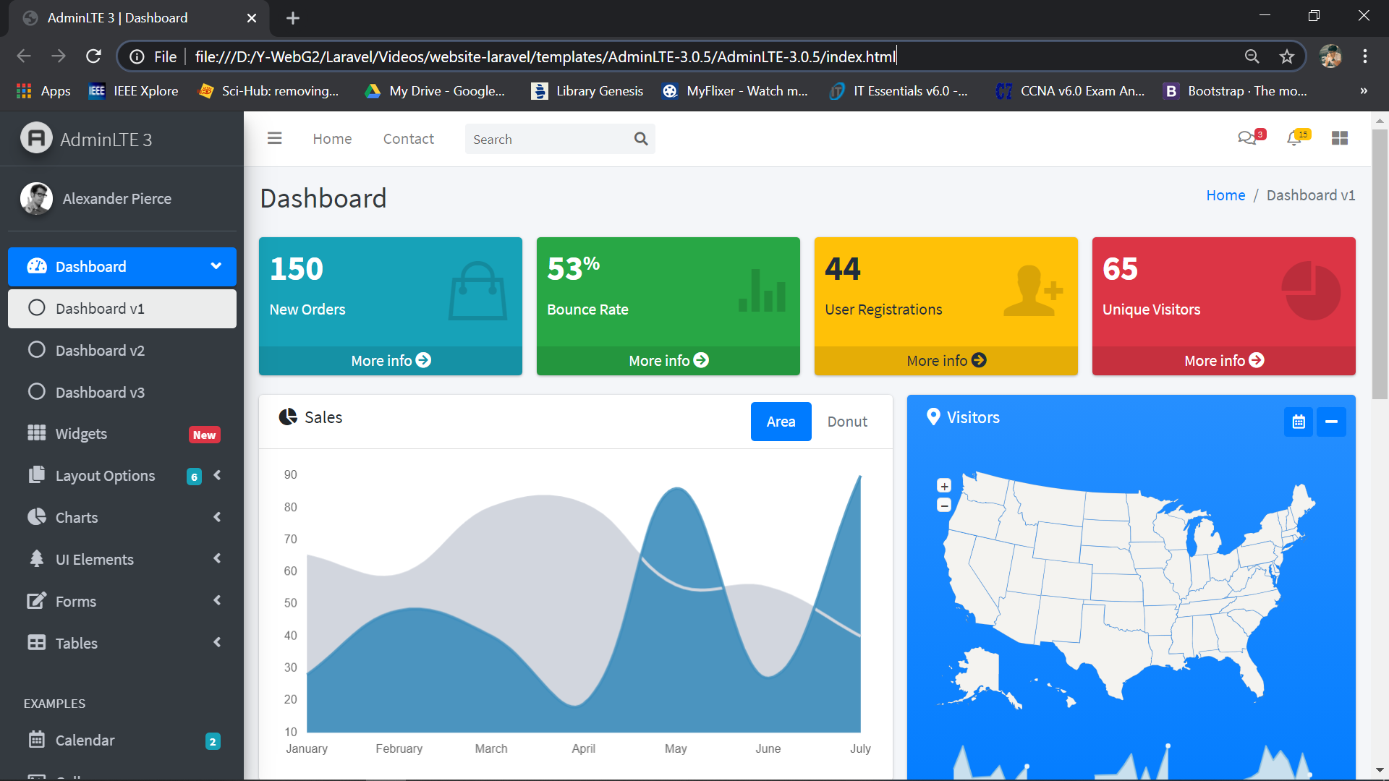
Bootstrap Template
For Backend
https://adminlte.io
https://modularcode.io/modular-admin-html
PAGE 07

Slide 9
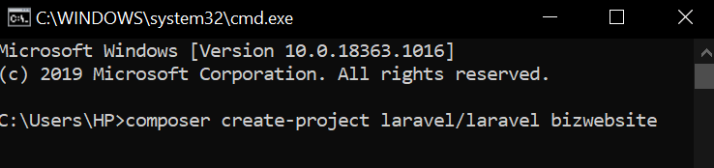
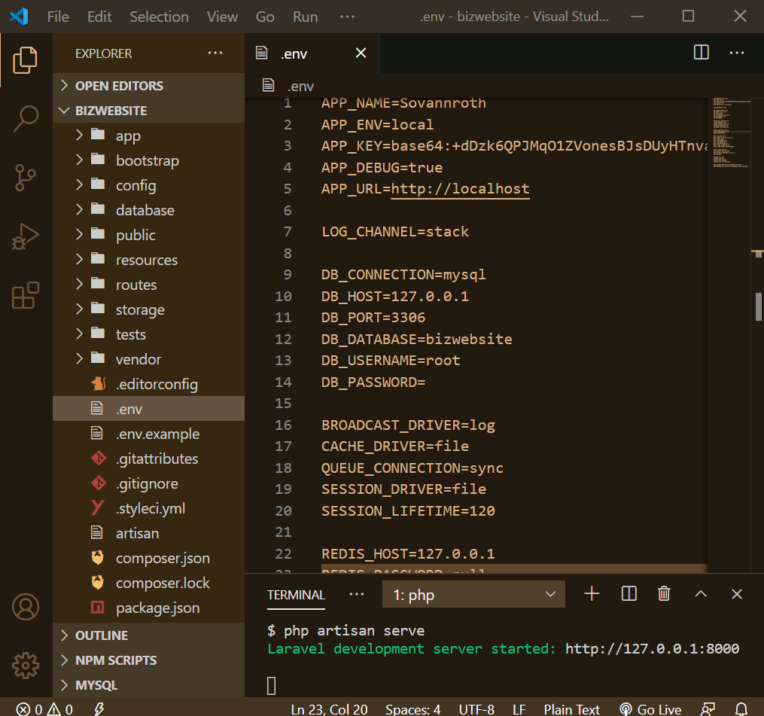
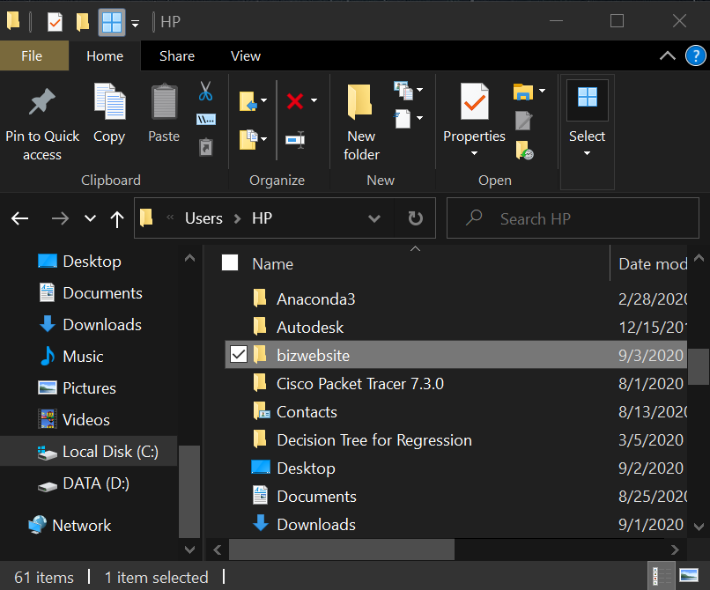
Installation Laravel for Project
Move Folder bizwebsite to C:\wamp64\www\
PAGE 08

Slide 10
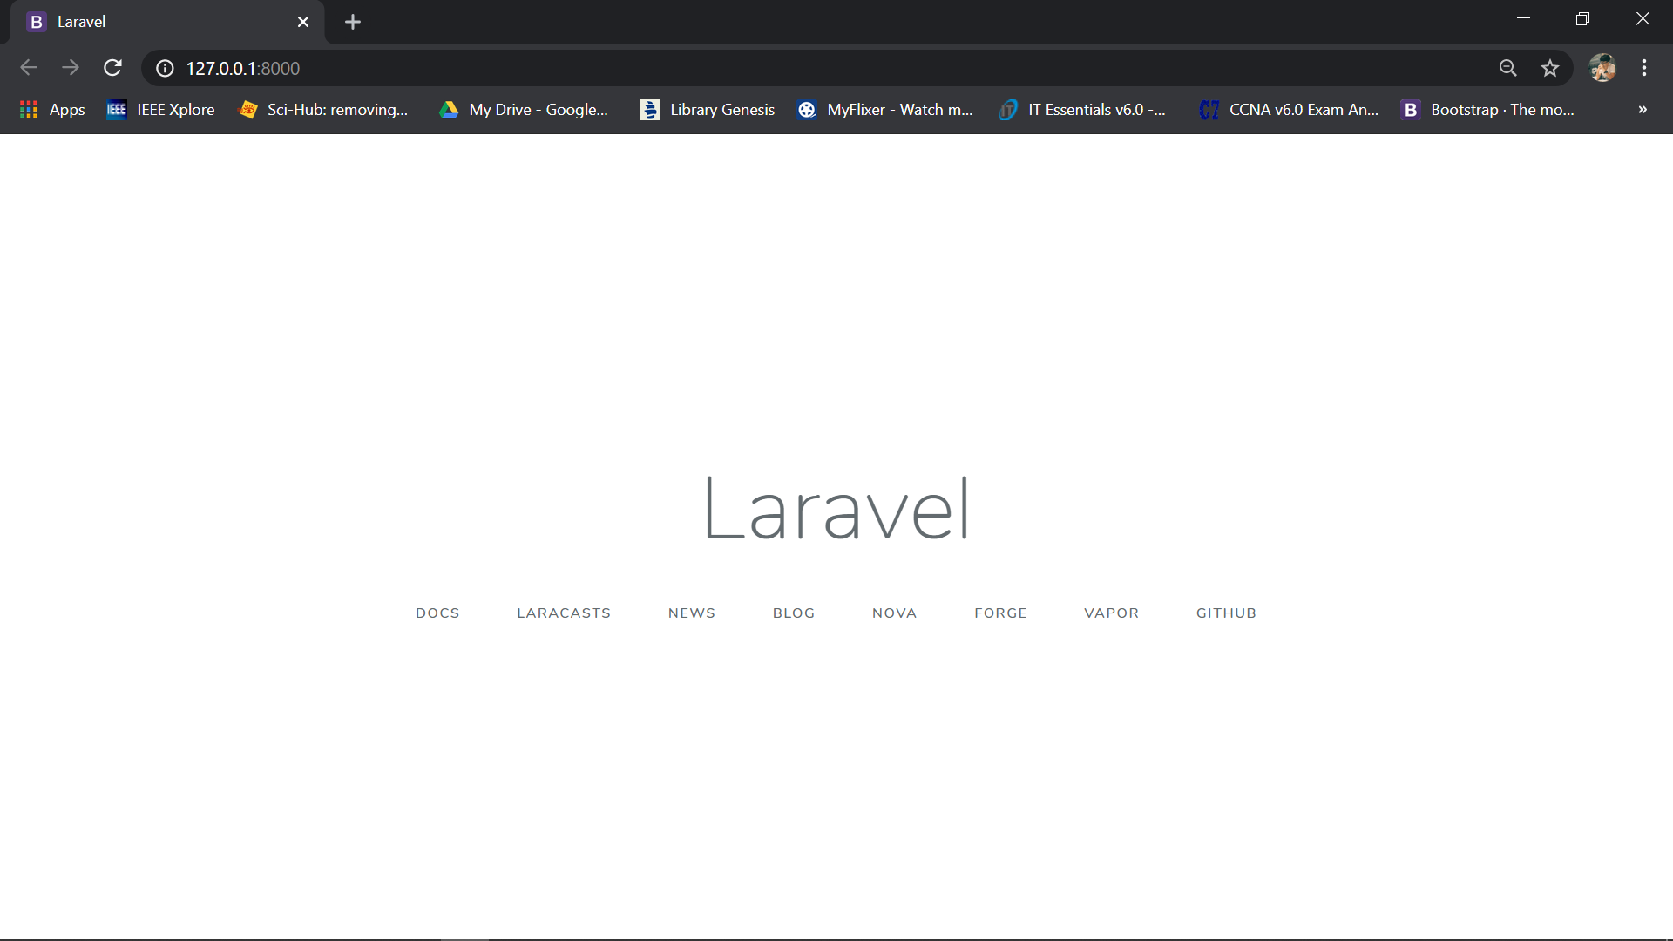
Running Server
Using command: ‘php artisan serve’ for running server.
PAGE 09

Slide 11
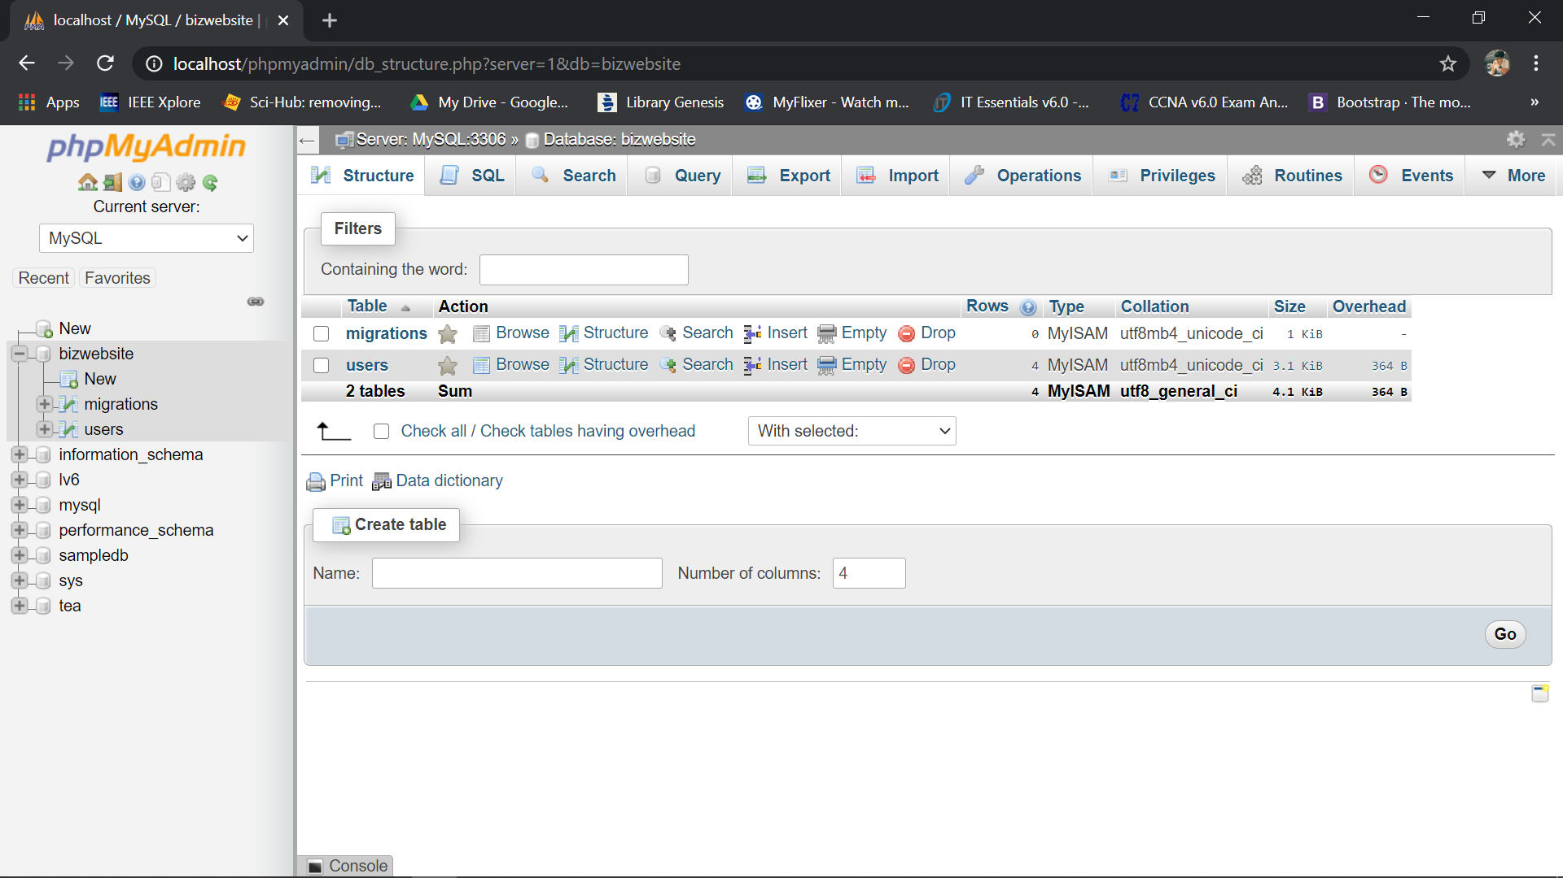
Creating Database MySQL
PAGE 10

Slide 12
Installation Laravel Module for Backend and Front-End
https://github.com/nWidart/laravel-modules
Stage1 Run command:
$ composer require nwidart/laravel-modules
$ php artisan vendor:publish --provider="Nwidart\Modules\LaravelModulesServiceProvider"
Stage2 add "Modules\\": "Modules/“ in file composer.json
{
"autoload": {
"psr-4": {
"App\\": "app/",
"Modules\\": "Modules/"
}
}
}
$ composer dump-autoload
Stage3 make module for Backend
$ php artisan module:make Admin
PAGE 11

Slide 13
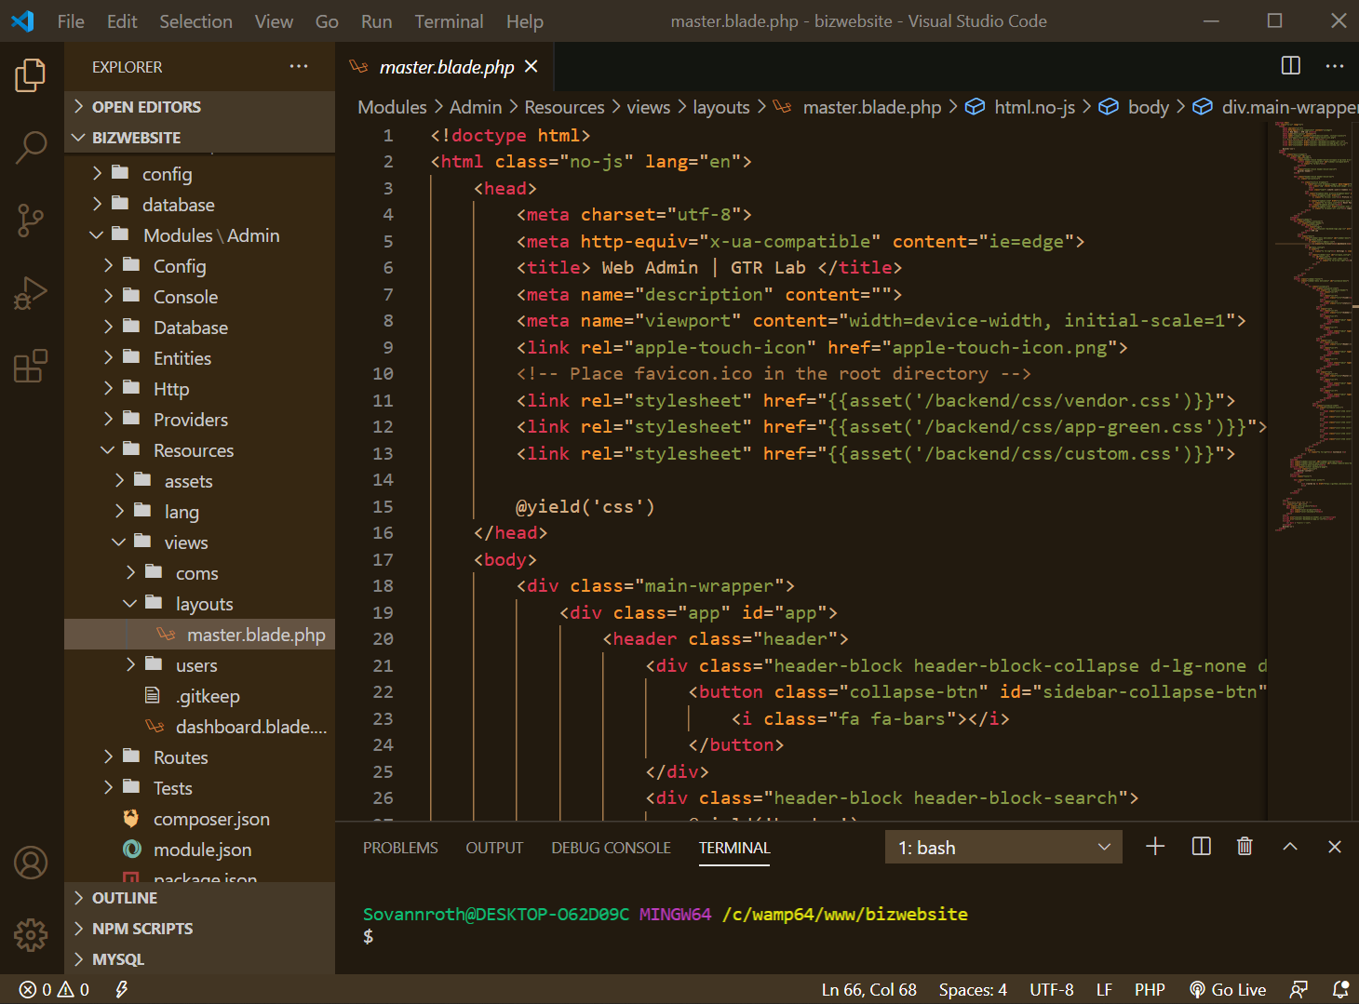
Module for Backend
PAGE 12

Slide 14
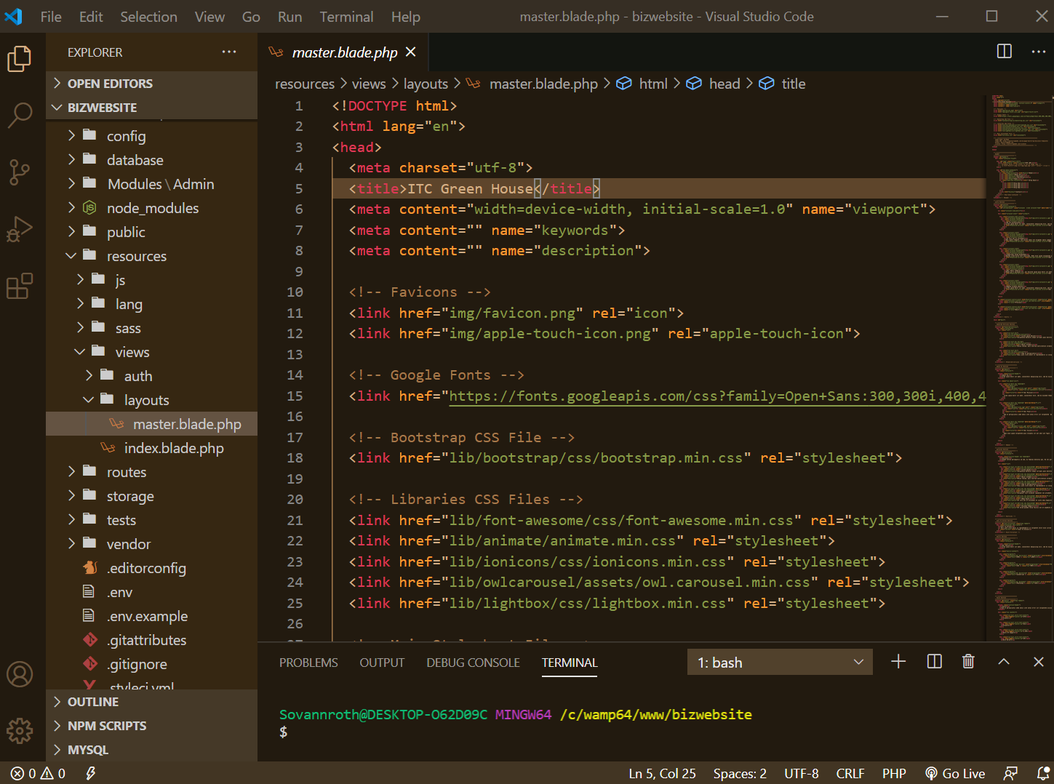
Module for Front-End
PAGE 13

Slide 15
Thank You!

